Slide 1
Relational Model
and
Relational Algebra

Slide 2
The Relational Data Model
By far, the most significant invention in the history of DBMS
– E.F. Codd, 1970
– Completely revolutionized the field ($9B market in 2001 according to Gartner) – Before it, network and hierarchical model: difficult to use and pose queries
– IBM System R: started in 1973 and completed around 1980. Later replaced by IBM DB2 system
• Simplicity at the logical level: a system optimizer takes care of performance.
Stilll dominant in commercial world: IBM, Oracle, Microsoft the main players
• A rich field of research conributions: E.g., Turing Awards E.F. Codd in 1981, Jim Gray in 1998, Mike Stonebraker in 2015.

Slide 3
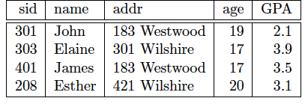
Relational Model
Example: Student(sid, name, addr, age, GPA)
All data is represented as relations (= tables)
Each relation has a set of attributes (= columns)
Each relation contains of a set of tuples (= rows)
Each attribute has a domain (= type)
– Only atomic types

Slide 4
Student(sid, name, addr, age, GPA)
sid | name | addr | age | GPA
301 | John | 183 Westwood | 19 | 2.1
303 | Elaine | 301 Wilshire | 17 | 3.9
401 | James | 183 Westwood | 17 | 3.5
208 | Esther | 421 Wilshire | 20 | 3.1
Class(dept, cnum, sec, unit, title, instructor)
dept | cnum | sec | unit | title | instructor
CS | 112 | 01 | 03 | Modeling | Dick Muntz
CS | 143 | 01 | 04 | DB Systems | Carlo Zaniolo
EE | 143 | 01 | 03 | Signal | Dick Muntz
ME | 183 | 02 | 05 | Mechanics | Susan Tracey
Enroll(sid, dept, cnum, sec)
sid | dept | cnum | sec
301 | CS | 112 | 01
301 | CS | 143 | 01
303 | EE | 143 | 01
303 | CS | 112 | 01
401 | CS | 112 | 01

Slide 5
Examples of Queries
Q1: Find the titles and instructors of all CS courses
Q2: All student names and GPAs who live on Wilshire
Q3: Find all student names who take CS classes.
Q4: All names of students and instructors
Q5: Find the names of pairs of students who live on the same addr
Q6: Find students taking at least two classes
Q7: Find all student names who take all CS classes (offered this quarter)
Q8: Find the names of students who is taking no CS classes (offered this quarter)

Slide 6
Relational Databases
Schema: defines the tables and data types for each table. Data Definition Language (DDL)
The Query Language. Two flavors:
  Relational Algebra: used as the basis of the actual execution model.
  Relational Calculus languages, logic-oriented and more declarative. Structured query language (SQL)

Slide 7
Relational Databases
Schema: defines the tables and data types for each table. Data Definition Language (DDL)
The Query Language. Two flavors:
  Relational Algebra: used as the basis of the actual execution model.
  Relational Calculus languages, logic-oriented and more declarative. Structured query language (SQL)

Slide 8
Relational Databases (cont).
Schema: defines the tables and data types for each table. Data Definition Language (DDL)
SQL and other DB languages are often called Data Manipulation Languages, because besides query can be used to request the following DB changes:
  Insert into a table,
  Delete from a table
  Update the records in a table
  Closure Properties: by applying queries or updat on tables we get back tables: e.g. Relation ➔ algebra ➔ Relation

Slide 9
Relational Algebra
Module 3, Lecture 1 from
Database Management Systems,
R. Ramakrishnan et al.
Notes:
1

Slide 10
Preliminaries
A query is applied to relation instances, and the result of a query is also a relation instance.
  Schemas of input relations for a query are fixed (but query will run regardless of instance!)
  The schema for the result of a given query is also fixed! Determined by definition of query language constructs.
Positional vs. named-field notation:
  Positional notation easier for formal definitions, named-field notation more readable.
  Both used in SQL
Notes:
4

Slide 11
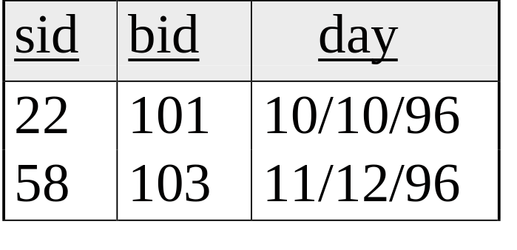
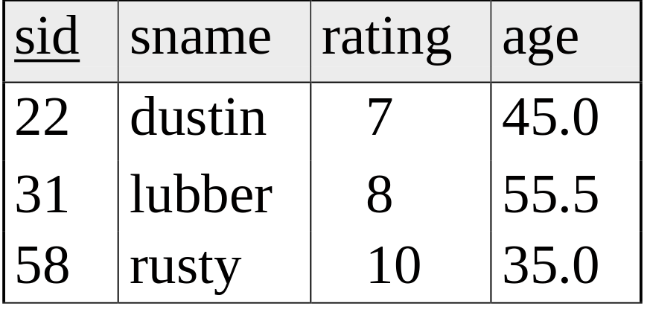
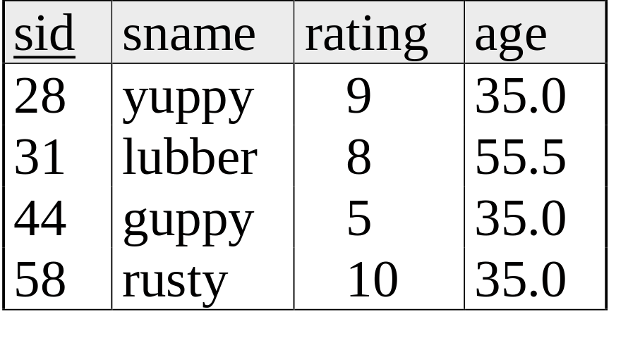
Example Instances
R1
“Sailors” and “Reserves” relations for our examples.
We’ll use positional or named field notation, assume that names of fields in query results are `inherited’ from names of fields in query input relations.
S1
S2
Notes:
5

Slide 12

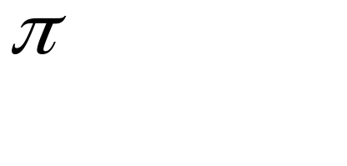
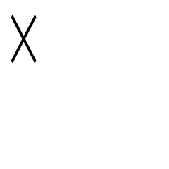
Relational Algebra
Basic operations:
  Selection Selects a subset of rows from relation.
  Projection Deletes unwanted columns from relation.
  Cross-product Allows us to combine two relations.
  Set-difference Tuples in reln. 1, but not in reln. 2. _
  Union Tuples in reln. 1 and in reln. 2. ∪
Additional operations:
  Intersection, join, division, renaming: Not essential, but (very!) useful.
Since each operation returns a relation, operations can be composed! (Algebra is “closed”.)
Notes:
6

Slide 13
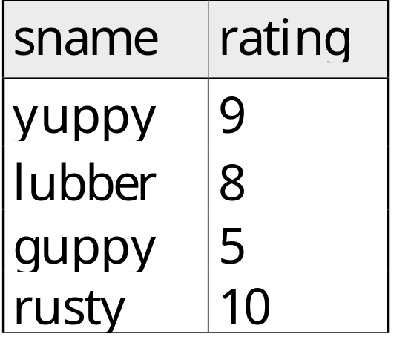
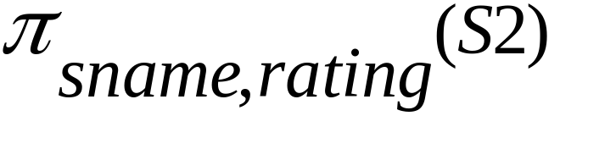
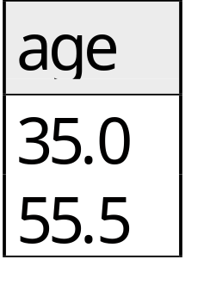
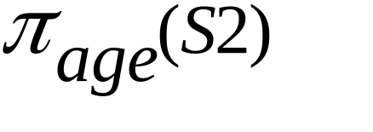
Projection
Deletes attributes that are not in projection list.
Schema of result contains exactly the fields in the projection list, with the same names that they had in the (only) input relation.
Projection operator has to eliminate duplicates! (Why??)
  Note: real systems typically dont do duplicate elimination unless the user explicitly asks for it. (Why not?)
Notes:
7

Slide 14
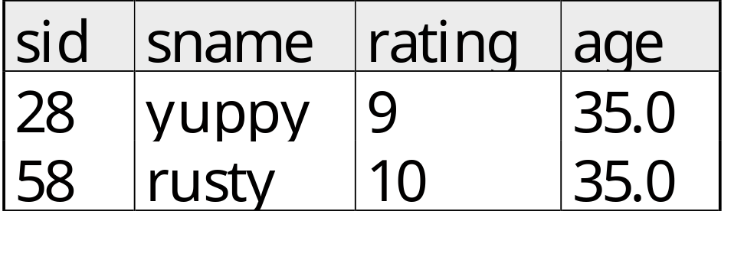
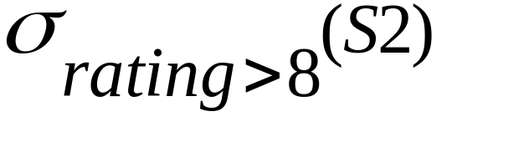
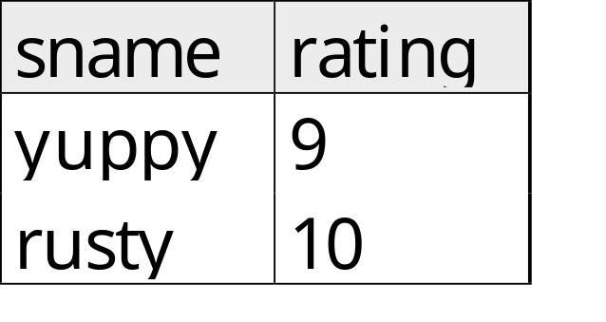
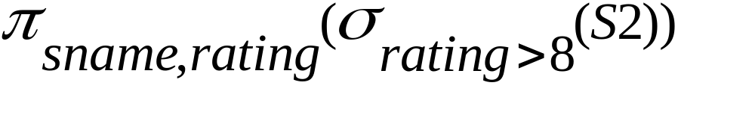
Selection
Selects rows that satisfy selection condition.
No duplicates in result! (Why?)
Schema of result identical to schema of (only) input relation.
Result relation can be the input for another relational algebra operation! (Operator composition.)
Notes:
8

Slide 15



Union, Intersection, Set-Difference
All of these operations take two input relations, which must be union-compatible:
  Same number of fields.
  `Corresponding’ fields have the same type.
What is the schema of result?
Notes:
9

Slide 16

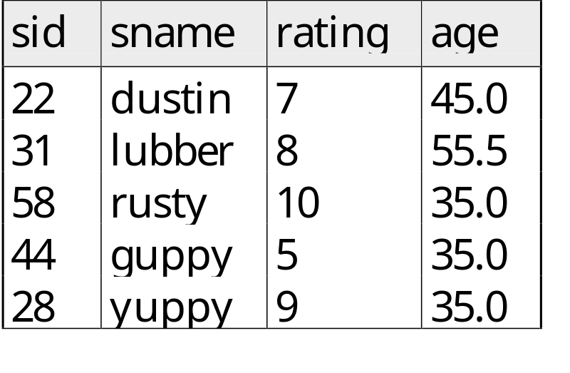

Union of Relations

Slide 17
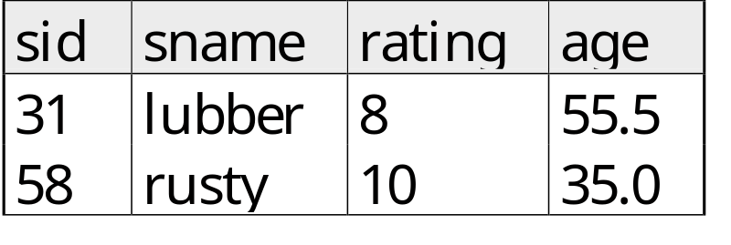
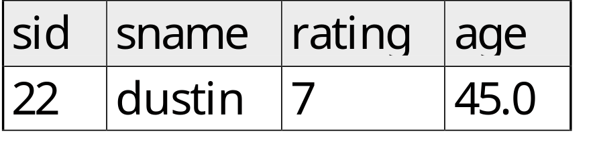
Intersection and Set-Difference

Slide 18
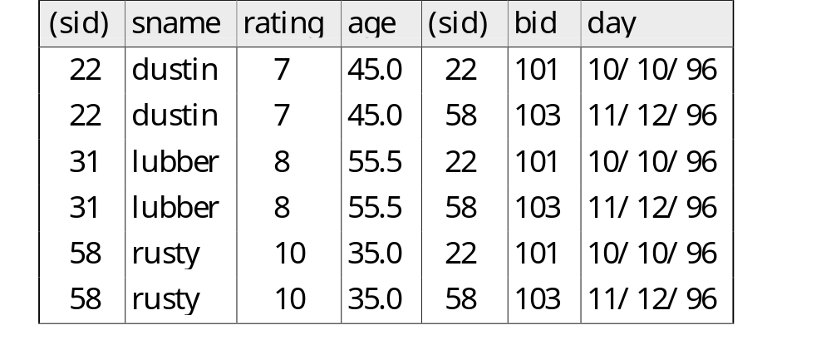
Cross-Product
Each row of S1 is paired with each row of R1.
Result schema has one field per field of S1 and R1, with field names `inherited’ if possible.
  Conflict: Both S1 and R1 have a field called sid.
Renaming operator:
Notes:
10

Slide 19

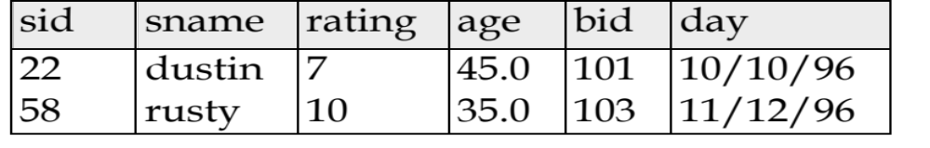
Equi-Joins
the condition contains only equalities:
Result schema similar to cross-product, but only one copy of fields for which equality is specified.
Natural Join: Equijoin on all common fields.
and
returns
Notes:
12

Slide 20
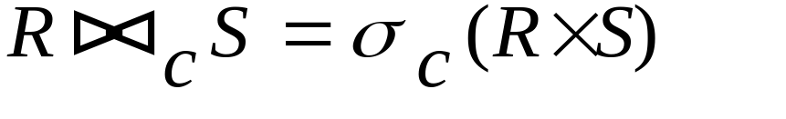
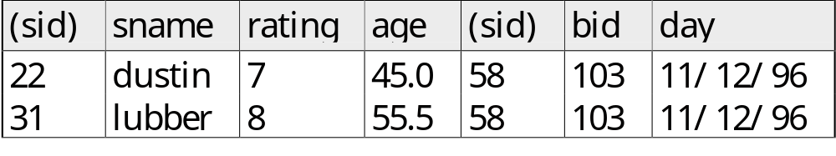
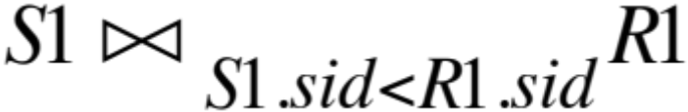
General Joins
Condition Join:
Result schema same as that of cross-product.
Fewer tuples than cross-product, might be able to compute more efficiently
Sometimes called a theta-join.
Notes:
11

Slide 21


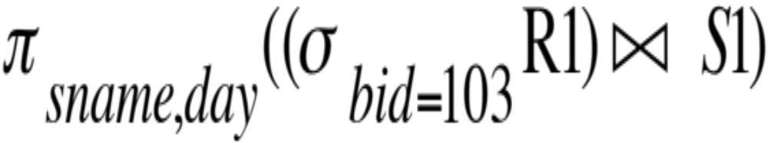
Query: Find names of sailors who have reserved boat #103 and when?
Solution 1:
Notes:
16

Slide 22
Student(sid, name, addr, age, GPA)
sid | name | addr | age | GPA
301 | John | 183 Westwood | 19 | 2.1
303 | Elaine | 301 Wilshire | 17 | 3.9
401 | James | 183 Westwood | 17 | 3.5
208 | Esther | 421 Wilshire | 20 | 3.1
Class(dept, cnum, sec, unit, title, instructor)
dept | cnum | sec | unit | title | instructor
CS | 112 | 01 | 03 | Modeling | Dick Muntz
CS | 143 | 01 | 04 | DB Systems | Carlo Zaniolo
EE | 143 | 01 | 03 | Signal | Dick Muntz
ME | 183 | 02 | 05 | Mechanics | Susan Tracey
Enroll(sid, dept, cnum, sec)
sid | dept | cnum | sec
301 | CS | 112 | 01
301 | CS | 143 | 01
303 | EE | 143 | 01
303 | CS | 112 | 01
401 | CS | 112 | 01

Slide 23
Queries
Q1: Find the titles and instructors of all CS courses
Q2: All student names and GPAs who live on Wilshire
Q3: Find all student names who take CS classes.
Q4: All names of students and instructors
Q5: Find the names of pairs of students who live on the same addr
Q6: Find students taking at least two classes
Q7: Find all student names who take all CS classes (offered this quarter)
Q8: Find the names of students who is taking no CS classes (offered this quarter)

Slide 24
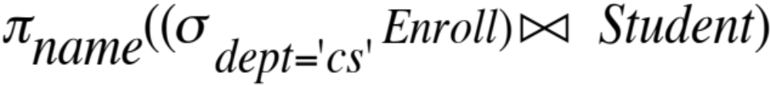
Student(sid, name, addr, age, GPA)
Class(dept, cnum, sec, unit, title, instructor)
Enroll(sid, dept, cnum, sec)
Q3: Find all names of students taking some (i.e., one or more) CS class.
Q5: Find the names of pairs of students who live on the same addr
Q6: Find students who do not live at “301 Wilshire”
Q8: Find the names of students who are taking no CS classes (offered this quarter)
Q7: Find all students who take all CS classes (offered this quarter)

Slide 25

sid
301
303
401
208
dept | cnum | sec | unit
CS | 112 | 01 | 03
CS | 143 | 01 | 04
EE | 143 | 01 | 03
ME | 183 | 02 | 05
dept | cnm | sec | unit
CS | 112 | 01 | 03
CS | 143 | 01 | 04
EE | 143 | 01 | 03
ME | 183 | 02 | 05
Enroll(sid, dept, cnum, sec)
sid | dept | cnum | sec
301 | CS | 112 | 01
301 | CS | 143 | 01
303 | EE | 143 | 01
303 | CS | 112 | 01
401 | CS | 112 | 01

Slide 26
Division
R: A table where all students takes all CS courses
sid | dept | cnum | sec
301 | CS | 112 | 01
301 | CS | 143 | 01
303 | CS | 112 | 01
303 | CS | 143 | 01
401 | CS | 112 | 01
401 | CS | 143 | 01
208 | CS | 112 | 01
208 | CS | 143 | 01
Enroll
sid | dept | cnum | sec
301 | CS | 112 | 01
301 | CS | 143 | 01
303 | EE | 143 | 01
303 | CS | 112 | 01
401 | CS | 112 | 01
sid | dept | cnum | sec
303 | CS | 143 | 01
401 | CS | 143 | 01
208 | CS | 112 | 01
208 | CS | 143 | 01
R – Enroll

Slide 27
Division
π_{sid}(R − Enroll):
π_{sid}(Student):
π_{sid}(Student) - π_{sid}(R − Enroll):
sid
303
401
208
sid
301
303
401
208
sid
301

